Slide 1

CxA at Georgia Tech
TRAINING OUTLINE
Overview of CxA
Overview of GT Commissioning
  CxA Philosophy + Approach
  How and when to use CxA
GT Templates and Standards
  CxA Narrative Review
  Responsibility Matrix Review
  IDIQ for CxA Review
  Fee Data Review
  GT Commissioning Specifications NEW!
  Template for Owner’s Project Requirements NEW!
Questions
Notes:
At Georgia Tech, the CxA is a critical member of the team for inspections – For BOR owned property, there is not a local jurisdiction inspecting MEP systems. We rely on the design team and the CxA to inspect work, in addition to special inspections and testing work.

Slide 2
What is Commissioning?
Systematic process, led by a Commissioning Agent (CxA), ensuring that all building systems perform interactively according to the design intent and the Owner’s operational needs.
  Third party verification of performance
  Energy optimization balanced with occupant comfort
  Design reviews for maintainability
  Assistance with EUI targets
  Review of conformance with GT YB
  Construction observation and installation verification
  Functional performance testing
  Owner training
Notes:
At Georgia Tech, the CxA is a critical member of the team for inspections – For BOR owned property, there is not a local jurisdiction inspecting MEP systems. We rely on the design team and the CxA to inspect work, in addition to special inspections and testing work.

Slide 3
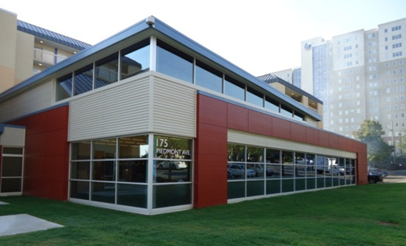
Commissioning Goals
Fully-Functional, Efficient, and Maintainable Facility
Reduce Change Orders / RFI’s
Ensure Envelope Integrity
Maximize Envelope Efficiency
Coordinate Component Constructability
Verify Trade Responsibility
Reduce Contractor Call-Backs
Avoid Costly Repairs
Educate O&M Staff on Building Equipment
Improve Component and Systems Life Cycle

Slide 4
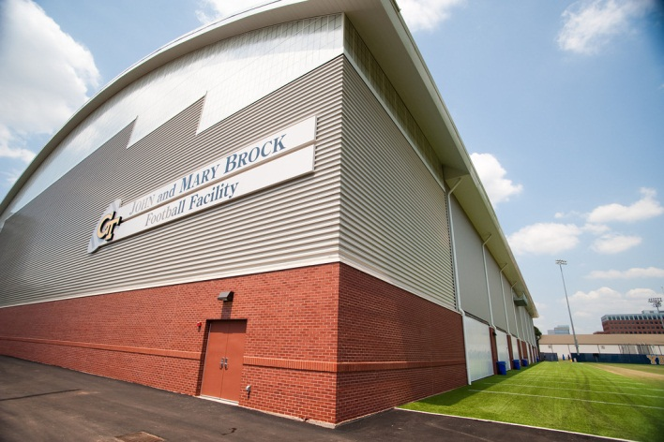
What Commissioning is Not
Design Engineering
Test and Balance
Construction Administration
Code Enforcement (yet)
Equipment Start-Up
Only a Documentation Effort

Slide 5
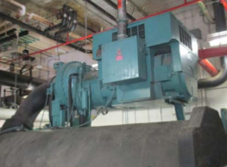
GT CxA - Approach Overview
GT Commissioning Overview
  Ensure that systems are designed to meet the project’s goals, and are installed, tested and function as intended, are operating to maximum efficiency and allow ease of maintenance.
  The CxA acts as a means to validate that staff is adequately trained and have the resources needed for proper operations and maintenance.

Slide 6
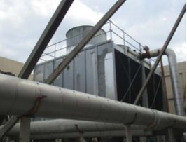
GT CxA - Approach Overview
GT Commissioning Overview
  Select the CxA during Concept Design and keep the CxA engaged contractually through the warranty period.
  The CxA should be considered a subject matter expert and an important member of the integrated design and construction team.

Slide 7
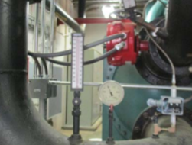
GT CxA - Approach Overview
When to Commission?
  As a guideline, The Energy Efficiency and Sustainable Construction Act of 2008, all new construction and major renovations over 10,000 SF shall be commissioned.
  Smaller projects with MEP scope of work, the replacement of significant MEP components (boilers, chillers, etc), projects with controls work or spaces with complex performance requirements.

Slide 8
GT CxA – Templates and Standards
    We have developed a number of standards, templates and procedures for Georgia Tech Commissioning:
    Commissioning Narrative
    Commissioning Responsibility Matrix
    IDIQ Contracting
    Fee Data
    GT CxA Specifications
    Template Owners Project Requirements (OPR)
Notes:
Commissioning requirements in project manual
Make sure TRAINING requirements for O+M staff are clearly identified. Suggest requiring professional videographer.
Creation of a Current Facility Requirements (CFR) document and O+M Manual at the completion of Commissioning.

Slide 9
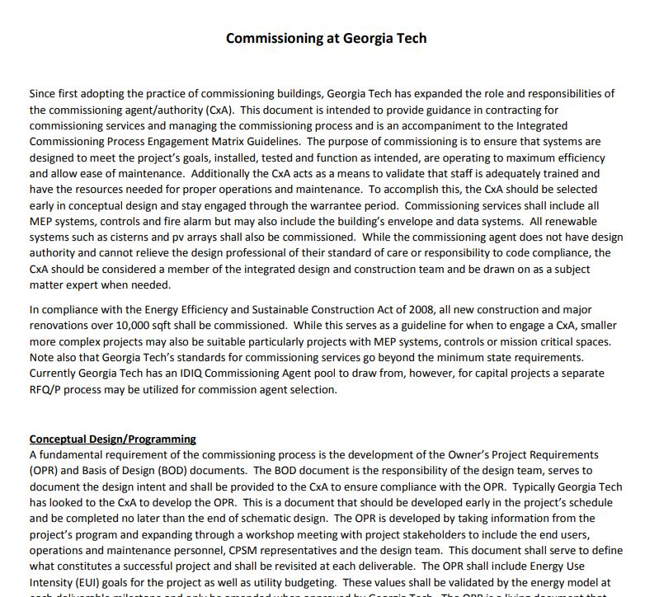
GT CxA – Commissioning Narrative
Commissioning Narrative
  Overview of GT commissioning approach, objectives, and expectations by project phase of work
  Developed by Georgia Tech D&C Engineering Department

Slide 10
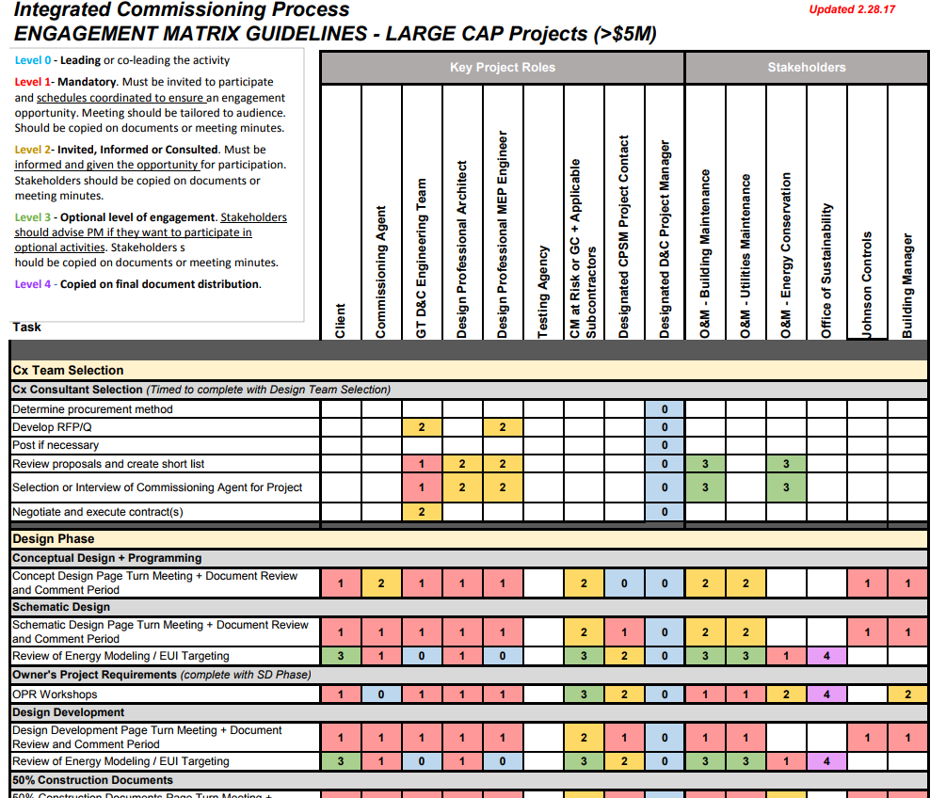
GT CxA – Engagement Matrix
CxA Engagement Matrix
  Working Committee developed CxA engagement matrix as a tool for project managers.
  Objective – Improve engagement of stakeholders and hand off to end users.
Notes:
Discuss that Garry Lockerman is A.D. of the Area Teams and PMs should reach out to him if they aren’t getting the input/engagement needed from O&M teams.

Slide 11
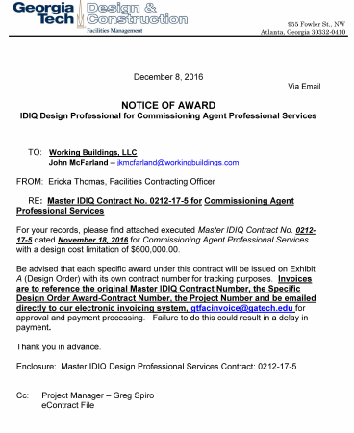
GT CxA – IDIQ Contracting
IDIQ Contracting
  For smaller projects, we maintain a number of IDIQ CxA contracts.
  CAP on contract values for IDIQ CxAs is $600K if no other contracts have been issued against the IDIQ.
  Currently the following firms are under contract: CxGBS, Epstein Group

Slide 12
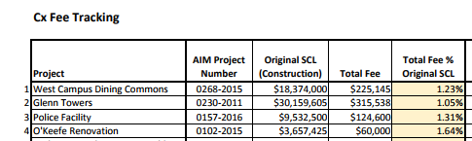
GT CxA – Cost of Services
Cost of CxA Services
  Fee Variables: duration of the project, # of field visits and meetings, complexity, warranty period engagement, M&V, or sustainability objectives such as low EUI, ASHRAE 189.1 compliance or LEED .
  Georgia Tech CxA services on larger capital projects are typically > 1.25% of the project SCL.

Slide 13
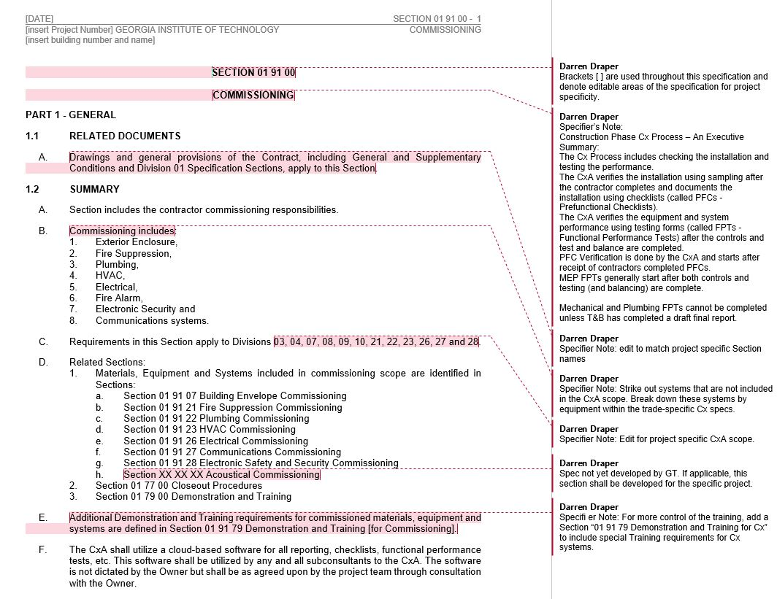
GT CxA - Commissioning Specifications
GT Commissioning Specifications
  PM should provide to the CxA during procurement.
  The CxA shall tailor the specifications to the project, and submit them to the Design Professional for inclusion in the Project Manual.
  A user guide and instructions to specifier are included.
Notes:
Discuss that Garry Lockerman is A.D. of the Area Teams and PMs should reach out to him if they aren’t getting the input/engagement needed from O&M teams.

Slide 14
GT Commissioning Specifications
GT Commissioning Specifications
  Specification Sections available:
      019100, General Commissioning Requirements
      019107, Building Enclosure Commissioning
      019121, Fire Suppression Commissioning
      019122, Plumbing Commissioning
      019123, HVAC Commissioning
      019126, Electrical Commissioning
      019127, Communications Commissioning
      019128, Electronic Safety and Security Commissioning
Notes:
Discuss that Garry Lockerman is A.D. of the Area Teams and PMs should reach out to him if they aren’t getting the input/engagement needed from O&M teams.

Slide 15
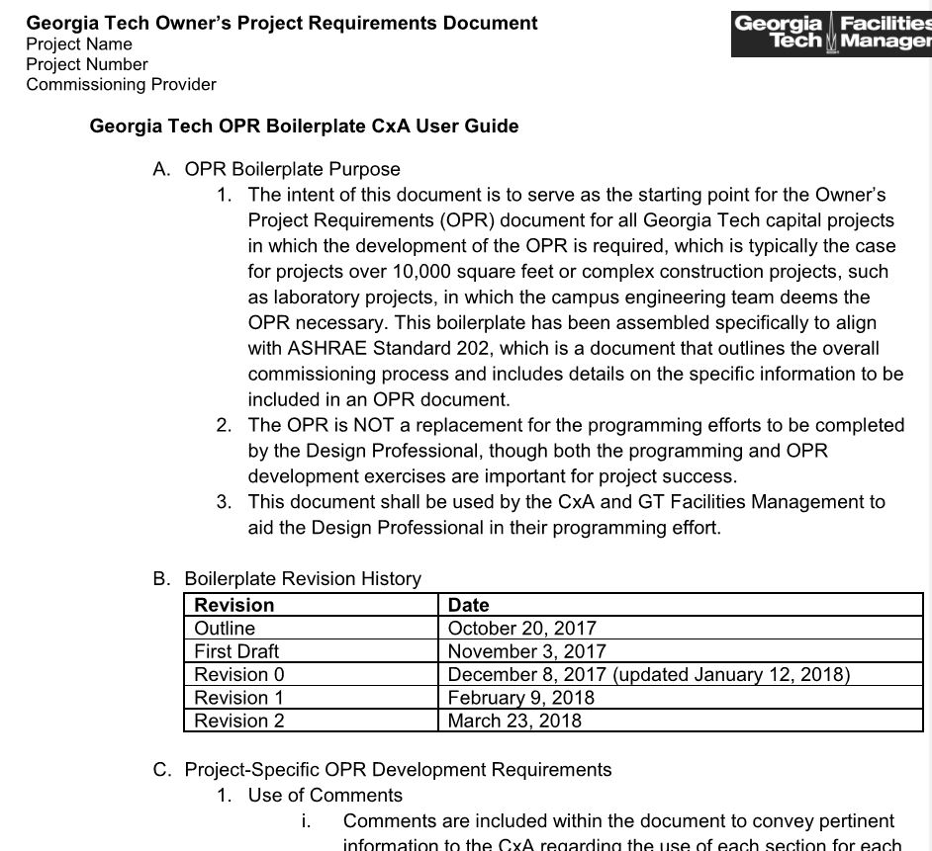
GT Cx – Owners Project Requirements
Georgia Tech OPR Template:
Consistent across all projects, streamlined, efficient, ease of use.
Baseline is GT Yellow Book
Notes:
Discuss that Garry Lockerman is A.D. of the Area Teams and PMs should reach out to him if they aren’t getting the input/engagement needed from O&M teams.

Slide 16
Owners Project Requirements
Owner’s Project Requirements: A written document that details the requirements of the project and the expectations of how it will be used and operated. This includes project goals, measurable performance criteria, cost considerations, benchmarks, success criteria, and supporting information.
Notes:
Discuss that Garry Lockerman is A.D. of the Area Teams and PMs should reach out to him if they aren’t getting the input/engagement needed from O&M teams.

Slide 17

Owners Project Requirements
Pre-Design Phase
  CxA and the OPR:
  OPR is a critical document in the Commissioning process
  CxA facilitates OPR development through workshops
  OPR should be updated throughout the project
OPR
Basis of Design
Dwgs & Specs
Submittals/ Shop Dwgs
Functional Tests
Final Updated OPR
Notes:
Discuss that Garry Lockerman is A.D. of the Area Teams and PMs should reach out to him if they aren’t getting the input/engagement needed from O&M teams.

Slide 18
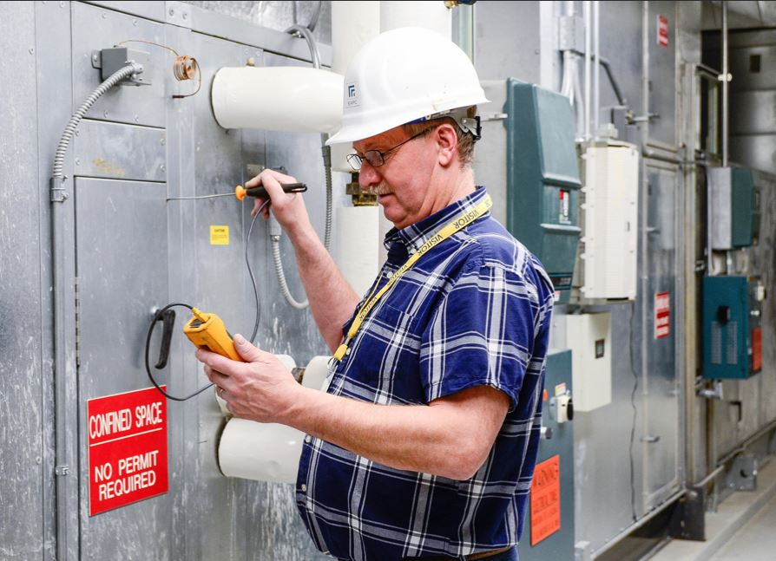
Owners Project Requirements
Pre-Design Phase
Program requirements
Codes and regulations
Site and climate
Facility context and function
Performance criteria
Sustainability goals
Cost
Schedule
Client’s needs and capabilities
Notes:
Discuss that Garry Lockerman is A.D. of the Area Teams and PMs should reach out to him if they aren’t getting the input/engagement needed from O&M teams.

Slide 19
Owners Project Requirements
APPROACH
OPR is the Foundation for Cx process
Major metrics, measurables covered in the OPR (EUI, temp/RH, pressurization, etc.)
Covers education/training requirements for end users and occupants.
OPR is a living document. Changes are documented as decisions are made, and revisions are tracked.
Converted to CFR (Current Facilities Requirements) upon project conclusion
Outline OPR
Workshop
IPD Design Meetings
Continual Updates
Convert to CFR
Notes:
Discuss that Garry Lockerman is A.D. of the Area Teams and PMs should reach out to him if they aren’t getting the input/engagement needed from O&M teams.

Slide 20
GT CxA – Templates and Standards
    RECAP – Now available on D&C Forms website:
    Commissioning Narrative
    Commissioning Responsibility Matrix
    IDIQ Contracting
    Fee Data
    GT CxA Specifications
    Template Owners Project Requirements (OPR)
Notes:
Commissioning requirements in project manual
Make sure TRAINING requirements for O+M staff are clearly identified. Suggest requiring professional videographer.
Creation of a Current Facility Requirements (CFR) document and O+M Manual at the completion of Commissioning.

Slide 21
GT Cx – Next Steps In Progress
In Development
  CxA RFPQ Template: We have hired Epstein Group to update our CxA RFPQ template document to incorporates new GT expectations, GT OPR, GT CxA specifications, responsibility matrix, etc. Goal is a coordinated suite of documents.
  Additional Training for O&M Team on CxA
  Simplified Engagement Matrix for Small Projects
  Quarterly Cx Roundtable
Notes:
Commissioning requirements in project manual
Make sure TRAINING requirements for O+M staff are clearly identified. Suggest requiring professional videographer.
Creation of a Current Facility Requirements (CFR) document and O+M Manual at the completion of Commissioning.

