Slide 1

CxA at Georgia Tech
TRAINING OUTLINE
Overview of CxA
Epsten Group, Darren Draper
Overview of Georgia Tech Commissioning
  GT CxA Philosophy + Approach
  How and when to contract CxA
  Costs for CxA
  Engagement of O&M + Building Occupants
  Other Tools in Development
Questions
Notes:
At Georgia Tech, the CxA is a critical member of the team for inspections – For BOR owned property, there is not a local jurisdiction inspecting MEP systems. We rely on the design team and the CxA to inspect work, in addition to special inspections and testing work.

Slide 2
What is Commissioning?
Systematic process, led by a Commissioning Agent (CxA), ensuring that all building systems perform interactively according to the design intent and the Owner’s operational needs.
  Third party verification of performance
  Energy optimization balanced with occupant comfort
  Design reviews for maintainability
  Assistance with EUI targets
  Review of conformance with GT YB
  Construction observation and installation verification
  Functional performance testing
  Owner training
Notes:
At Georgia Tech, the CxA is a critical member of the team for inspections – For BOR owned property, there is not a local jurisdiction inspecting MEP systems. We rely on the design team and the CxA to inspect work, in addition to special inspections and testing work.

Slide 3
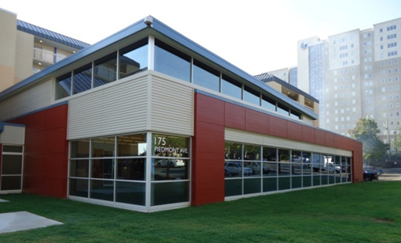
Commissioning Goals
Fully-Functional, Efficient, and Maintainable Facility
Reduce Change Orders / RFI’s
Ensure Envelope Integrity
Maximize Envelope Efficiency
Coordinate Component Constructability
Verify Trade Responsibility
Reduce Contractor Call-Backs
Avoid Costly Repairs
Educate O&M Staff on Building Equipment
Improve Component and Systems Life Cycle

Slide 4
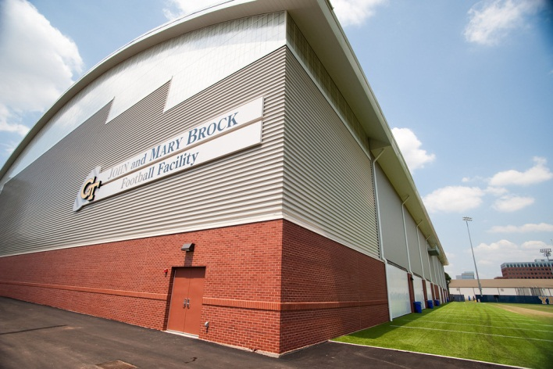
What Commissioning is Not
Design Engineering
Test and Balance
Construction Administration
Code Enforcement (yet)
Equipment Start-Up
Only a Documentation Effort

Slide 5

Communication/Integration
  Importance of communication from outset cannot be overstated
  Begins with integration of CxA into design and construction teams
  CA should be looped into project team early in design
  At GT, we now prefer to engage the CxA early in the project – typically during SD.
  Buy-in of team members critical for success
  CxA more of a role player than just an inspector
    Identify pitfalls
    Generate honest feedback
    Propose real, practical solutions
Project Team
Owner
A/E
CM/GC
CxA

Slide 6
Commissioning Phases
Design Phase
Acceptance Phase
Construction Phase
Warranty Phase

Slide 7
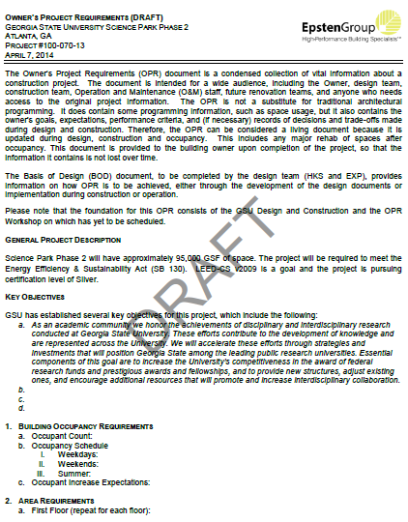
Design Phase
Design Phase
OPR & BOD
  Create Owner’s Project Requirement via OPR Workshop
  Verify Basis of Design consistent with the OPR
    Design Document Reviews (Systems)
  Commissionability
  Maintainability
  Energy Model QC
    Best Practices (Systems)
  Energy optimization strategies
  Engineering assumptions
  Past experience/lessons learned applications
    O&M Training Requirements and Specifications
Notes:
Slide 7: Can Darren remind those in the room that at GT, “owners” means both building occupants and building operators. So, for OPR and O&M training requirements, getting input from appropriate “owners” is important. He can mention that Greg or others from GT will go into this in more detail further on.

Slide 8
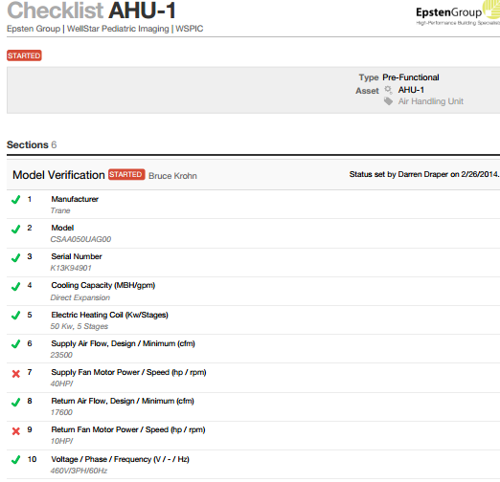
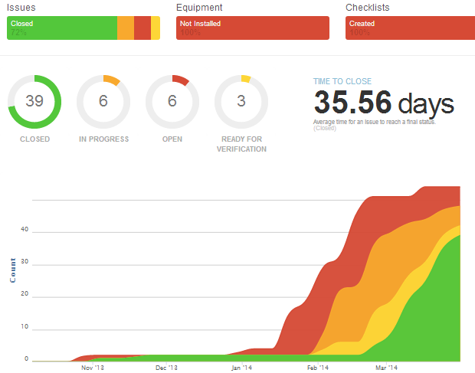
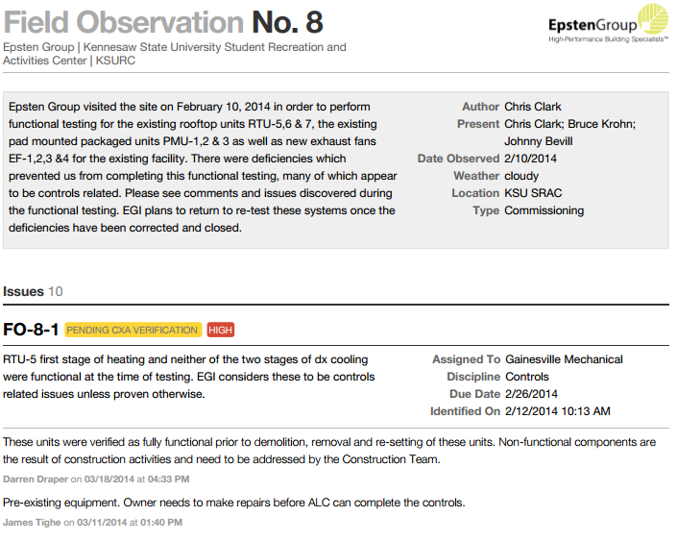
Construction Phase
Construction Phase
Cx into the construction schedule!
Kick-off Meeting
Submittal/Shop Drawing reviews
Installation Verification
  Review installation of systems and components for access and long-term maintenance
Site Visit Reports and Observation Logs
Major equipment start-up and pressure testing
Progress Meetings

Slide 9
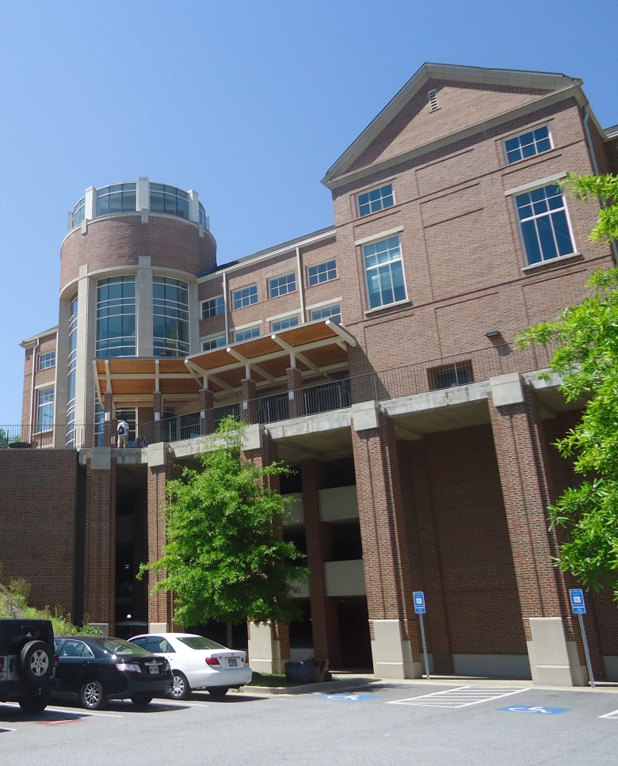
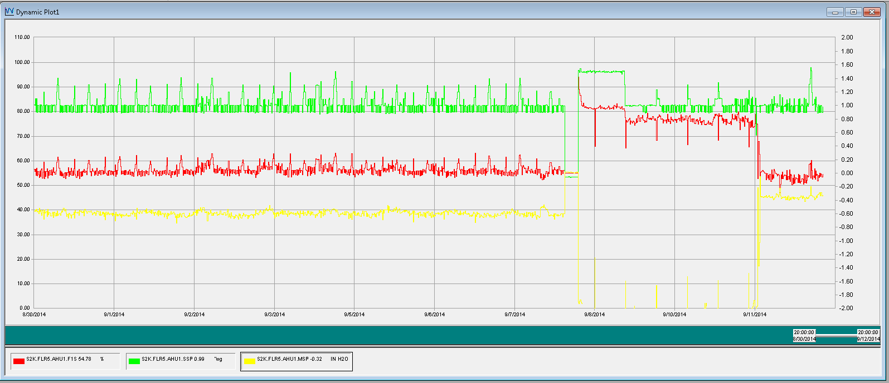
Acceptance Phase
Acceptance Phase
Verify Test & Balance (TAB)
Systems Functional Performance Testing
  Contractor preparedness (ready for testing)
  NOT A CHECKLIST
  No sampling of major equipment
  Detailed steps based on Sequence of Operation
  O&M staff participation encouraged
  Integrated Systems Test
  Trending implementation and review

Slide 10

Acceptance Phase
Acceptance Phase
  O&M Training Plan
  Training development meeting with owner and GC
  Assist owner and GC with training plan development
  CxA-Led Training Session
  Sequences of Operation review
  Systems component identification
  Functional testing review
Training should:
  Identify operational intent
  Empower maintenance staff
  Provide troubleshooting techniques
  Include desired response to major incidents
Proper training crucial to equipment longevity and sustained energy performance

Slide 11
Warranty Phase
Warranty Phase
  Seasonal testing
  10-Month warranty review
  Building occupants and O&M Staff interviews
  Review O&M log
  Identify warranty-related issues
  Review system operation
  DDC system trend data, alarms, set points, etc.
  Report issues to Owner and GC for resolution
  Issues must be resolved prior to warranty expiration
Final Commissioning Report

Slide 12
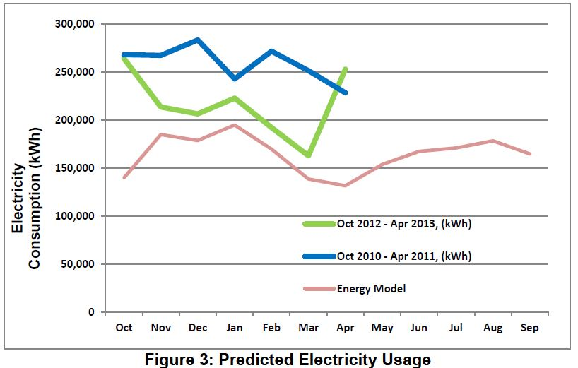
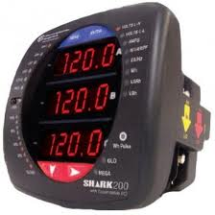
Post-Occupancy M&V
M&V critical to verify persistence of building performance compared to design
Put M&V infrastructure in place early in design
Provide M&V consistent with Owner’s interests and needs
M&V Plan/Options
  HVAC loads
  Lighting loads
  Main power
  Cooling and heating water
“Measurement is the first step that leads to control and eventually to improvement.”
- H James Harrington

Slide 13

Building Systems to Consider
Energy-Using Systems
  HVAC and HVAC Controls
  Lighting Controls
  Daylight Dimming Controls
  Domestic Water Heating Systems
Life Safety
  Fire Alarm/Fire Protection
  Emergency Power
Other
  Plumbing
  Security and Access Control
  A/V, Data/Network
  Vertical Transportation
  Specialty Systems

Slide 14
Building Systems to Consider
Building Envelope
  Roof, Curtain Wall, Skin Systems
  Mock Up Reviews
Renewable Energy Systems
  Photovoltaics
  Solar Water Heating
  Cogeneration
  Wind Turbines

Slide 15

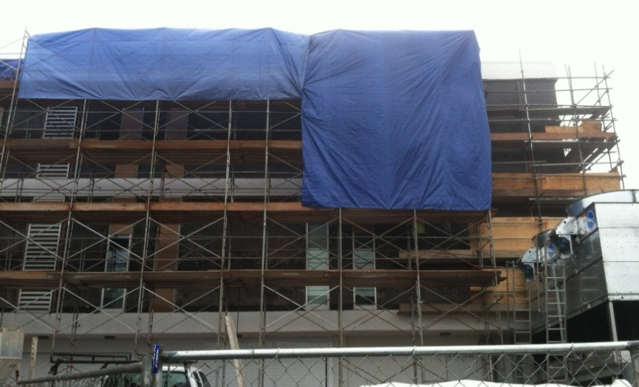

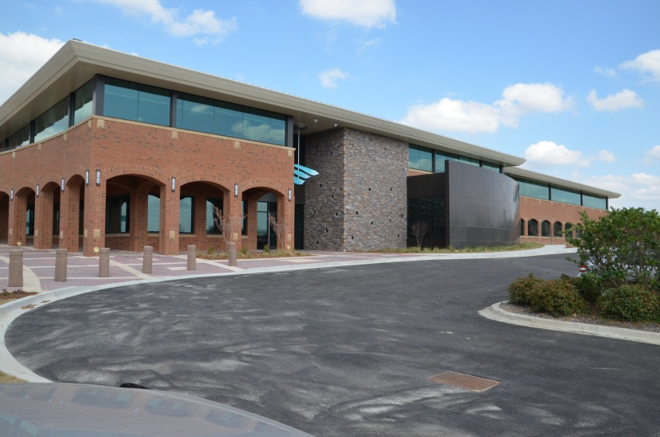
ENVELOPE COMMISSIONING

Slide 16
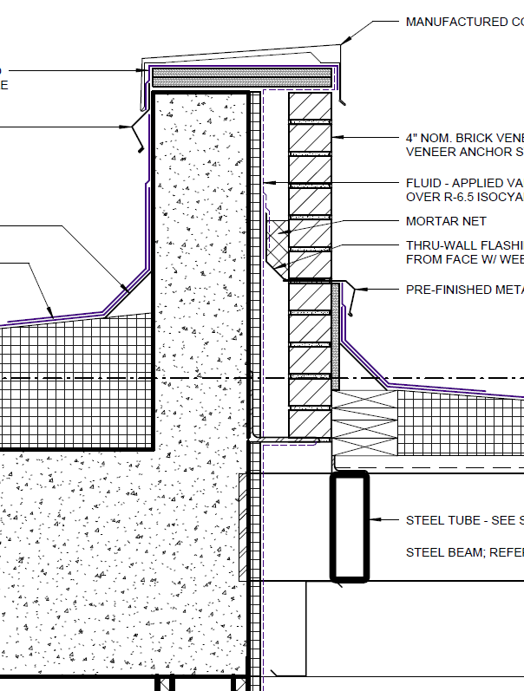
BECx – Design Phase
Similar to Systems Commissioning, Envelope Commissioning (BECx) is the third-party process of reviewing the design and construction of envelope.
The Design Phase of the process consists of the following steps:
  Creation/Review of Owner’s Project Requirements (OPR) and designer’s Basis of Design (BOD)
  Commissioning Kick-Off Meeting
  Commissioning Plan
  Design Document Reviews
  Commissioning Specifications including Envelope/Mock-Up Testing Specifications
  Development of Installation Checklists

Slide 17

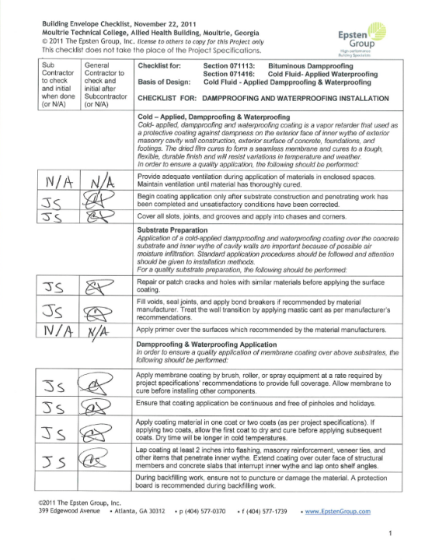
BECx – Construction Phase
The Construction Phase of the BECx process includes:
  Submittal and shop drawing reviews
  Envelope construction checklists
  Pre-Installation meetings with the various envelope subcontracting trades to set clear expectations and responsibilities.
  Site observations
  Mock-up reviews and testing
  Envelope testing
  Envelope final inspection

Slide 18
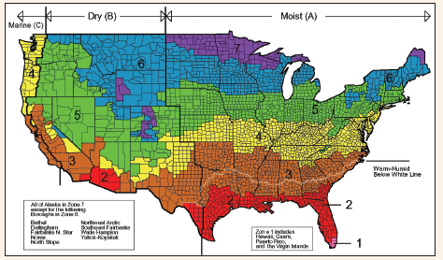
Envelope Testing
Testing generally falls into one of two areas:
  Water Tightness
    Water leakage testing
    Combined air and water testing
    Flood testing
    Infrared thermography
    Electronic Leak Detection (ELD)
  Air Tightness
    Blower door testing
    Combined blower door/IR testing
    Adhesion/thickness testing
Testing strategies should be tailored to climate. Air testing techniques more important in colder climates and water testing in warmer climates.

Slide 19
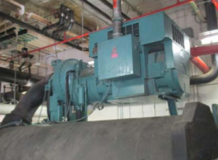
GT Cx - Approach Overview
GT Commissioning Overview
  Ensure that systems are designed to meet the project’s goals, and are installed, tested and function as intended, are operating to maximum efficiency and allow ease of maintenance.
  The CxA acts as a means to validate that staff is adequately trained and have the resources needed for proper operations and maintenance.

Slide 20
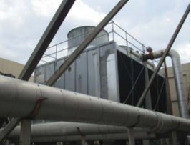
GT Cx - Approach Overview
GT Commissioning Overview
  Select the CxA during Concept Design and keep the CxA engaged contractually through the warranty period.
  The CxA should be considered a subject matter expert and an important member of the integrated design and construction team.

Slide 21
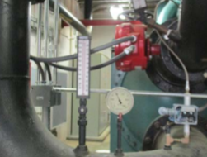
GT Cx - Approach Overview
When to Commission?
  As a guideline, The Energy Efficiency and Sustainable Construction Act of 2008, all new construction and major renovations over 10,000 SF shall be commissioned.
  Smaller projects with MEP scope of work, the replacement of significant MEP components (boilers, chillers, etc), projects with controls work or spaces with complex performance requirements.
  Resource:
  A narrative overview of the commissioning process and a list of CxA terms with definitions has been developed and is available on the D&C Forms Website

Slide 22
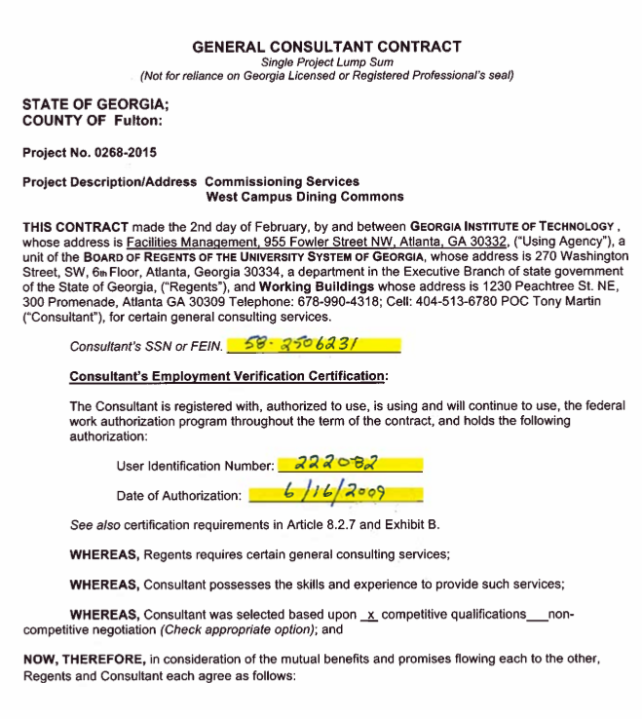
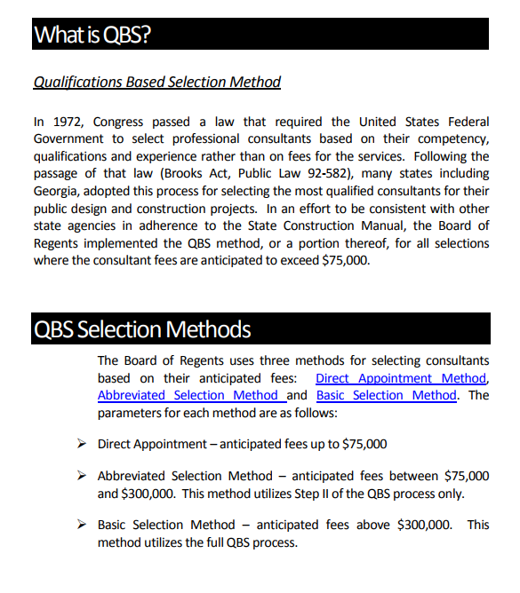
GT Cx – Procurement + Contracting
Contracting Relationship for CxA
  General Consulting Contract
  Hired by GT, for direct reporting relationship, but integrated into the design and construction team.
  Get the CxA on board as early to assist with overall energy goals, design approach to MEP systems. (Engage by 50% SD as a guideline.)
Qualification Based Selection
  For larger projects, a template RFP/Q with a detailed scope of work is available on the forms website. Interviews are always required.

Slide 23
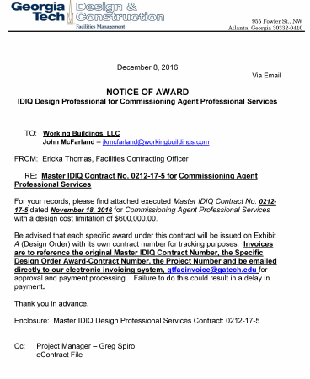
GT Cx - Procurement + Contracting
IDIQ Contracting
  For smaller projects, we maintain a number of IDIQ CxA contracts.
  CAP on contract values for IDIQ CxAs is $600K if no other contracts have been issued against the IDIQ.
  Currently the following firms are under contract: Burns McDonnell, CxGBS, Epstein Group, ICE, Working Buildings.
  Resource:
  An RFP/Q template, QBS selection guidelines, and a list of current IDIQ CxA contracts are available on the D&C Forms Website.

Slide 24
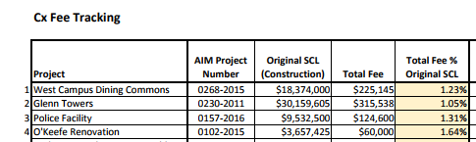
GT Cx – Cost of Services
Cost of CxA Services
  Fee Variables: duration of the project, # of field visits and meetings, complexity, warranty period engagement, M&V, or sustainability objectives such as low EUI, ASHRAE 189.1 compliance or LEED .
  Georgia Tech CxA services on larger capital projects are typically > 1.25% of the project SCL.
  Resource:
  A spreadsheet of CxA fees for recent projects
  is available on the D&C Forms Website.

Slide 25
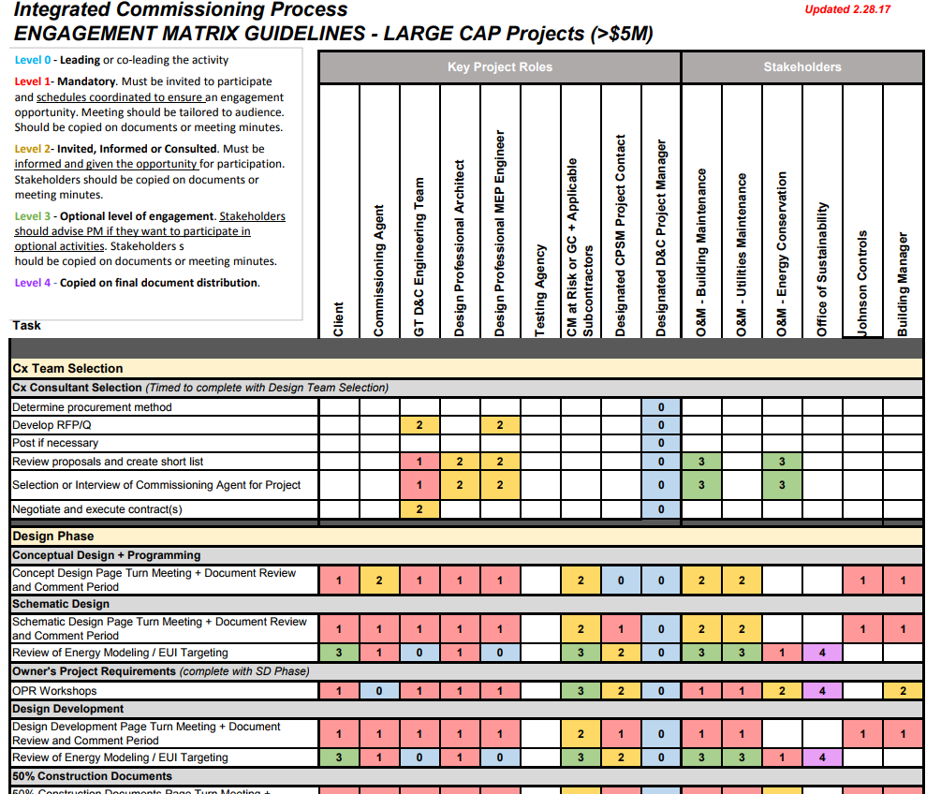
GT Cx – Engagement Matrix
CxA Engagement Matrix
  Working Committee developed an CxA engagement matrix as a tool for project managers.
  Objective – Improve hand off and engagement of O&M team.
O&M- Design Engagement
  Participation in OPR development and review, as well as energy modeling and EUI targets.
  Page turn meetings: SD, DD, CD
Notes:
Discuss that Garry Lockerman is A.D. of the Area Teams and PMs should reach out to him if they aren’t getting the input/engagement needed from O&M teams.

Slide 26
GT Cx – Engagement Matrix
O&M - Construction
  Cx Kick Off Meeting + Bi-weekly
  50% complete, 80% complete
  Wall / ceiling cover up inspections
  MEPF inspection walks with CxA or engineers
  Equipment start up and functional performance testing.
O&M - Training
  Manufacturer training
  Building management and systems training overview
  Metysis interface training and troubleshooting

Slide 27
GT Cx – Engagement Matrix
Warranty Phase, M&V + Diagnostics
  Set the CxA up with Metysis access during construction so that they can start reviewing trend data. (Send a help desk
  Quarterly M&V meeting to review building operation and trends, outstanding warranty issues
  Meetings should include CxA, project manager, O&M, building manager
  Seasonal TAB, as applicable
  Ten month warranty walk
  Resource:
  The CxA process and engagement matrix is posted on the forms website.
Notes:
Mention quarterly O&M meetings in the Warranty Phase that we did on Glenn & Towers as a good practice to replicate.

Slide 28
GT Cx – Next Steps In Progress
In Development
  We have hired Epstein Group to develop additional resources which should be available within six months:
    Boiler Plate OPR Document: develop a consistent OPR format and baseline requirements that tie to the yellow book for use as a starting point for project specific OPRs.
    CxA Specifications: GT specific commissioning specifications and requirements for inclusion in project documents.
  Additional Training for O&M Team on CxA
  Simplified Engagement Matrix for Small Projects
  Quarterly Cx Roundtable
Notes:
Commissioning requirements in project manual
Make sure TRAINING requirements for O+M staff are clearly identified. Suggest requiring professional videographer.
Creation of a Current Facility Requirements (CFR) document and O+M Manual at the completion of Commissioning.

